Slide 1
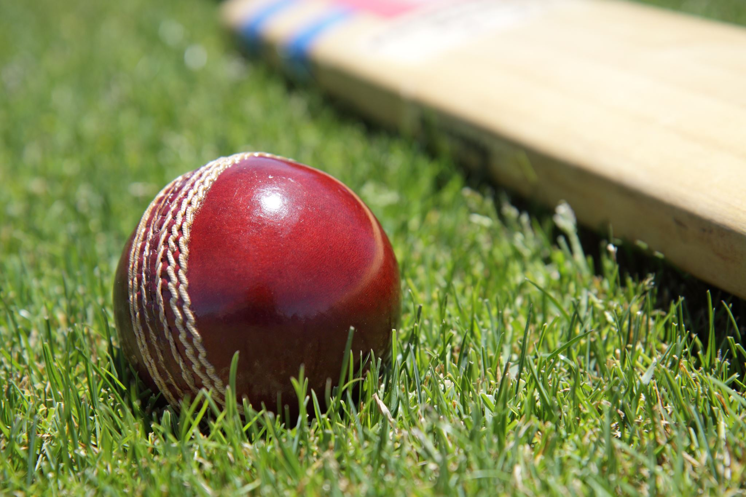
"IPL Infographics: A Data Visualization Journey"
Submitted by-
- Dolli Rawat
- Dimple Katla
- Shaurya Raj
- Vishakha Gaikwad
- Vaibhav Parabhane
"Analyzing Indian Premier League (IPL) Data Through Statistics and Visualizations"

Slide 2

Introduction
Objective
Analyze and visualize IPL data to create engaging infographics.
Highlight player performances, team statistics, and trends.
Significance
Simplify complex data for fans and analysts.
Enhance skills in data analytics and visualization.

Slide 3

Project Overview
Key Components:
Introduction to IPL.
Basics of Pandas and its libraries.
Time series analysis using ARIMA and SARIMA.
Hands on work with datasets (matches.csv and deliveries.csv)
Goal: Create accessible insights from IPL seasons.

Slide 4
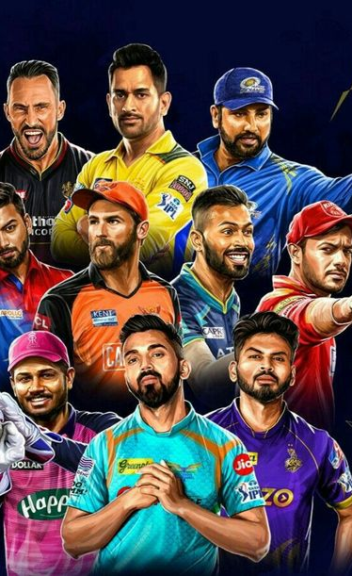
The Indian Premier League (IPL)
Key Features:
Franchise-based teams representing different cities.
Star-studded lineups with domestic and international players.
A mix of sports and entertainment with a massive global fan base.
Why Analyze IPL Data?
Popularity: Billions of viewers worldwide, making it a rich source of data.
Data Diversity: Contains player stats, team performances, match outcomes, and more.
Business Perspective: Offers insights into team strategies, player value, and fan engagement.

Slide 5

Types of Data Studied
Matches Dataset:
Includes match IDs, team names, toss decisions, venues, and results.
Helps in analyzing team performance trends over the seasons.
Deliveries Dataset:
Ball-by-ball details like batsmen, bowlers, runs scored, extras, and wickets.
Useful for micro-level analysis of player performances and match dynamics.
Insights Derived
Team performance trends across seasons.
Key players contributing to victories.
Toss influence on match outcomes.
Strategic decision-making, such as bowling changes or batting orders.
Impact of Data Visualization
Transforms raw data into meaningful infographics.
Enables fans and analysts to identify hidden trends and stories.
Bridges the gap between cricket enthusiasts and analytical perspectives.

Slide 6

Learning Pandas for IPL Analysis
What is Pandas?
A Python library for data manipulation and analysis.
Provides powerful tools for working with structured data like tables and time series.
Why Pandas for IPL Analysis?
Efficient handling of large datasets like matches.csv and deliveries.csv.
Simplifies complex operations such as filtering, grouping, and aggregations.

Slide 7
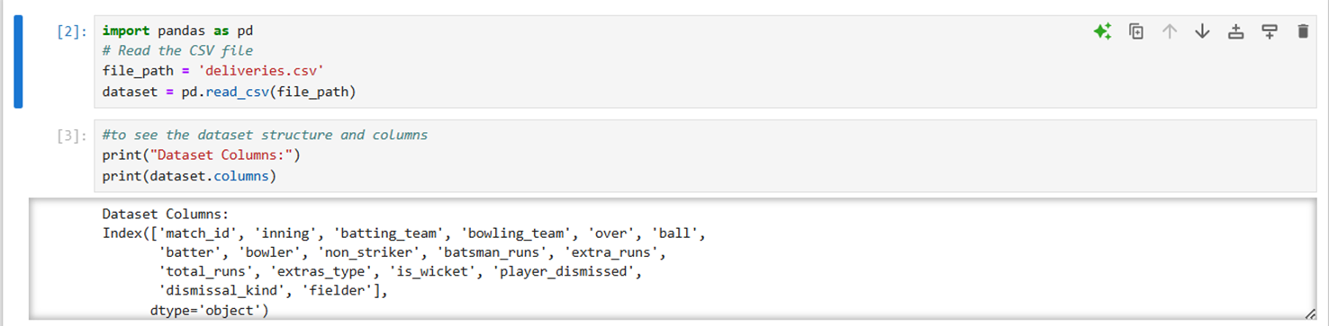
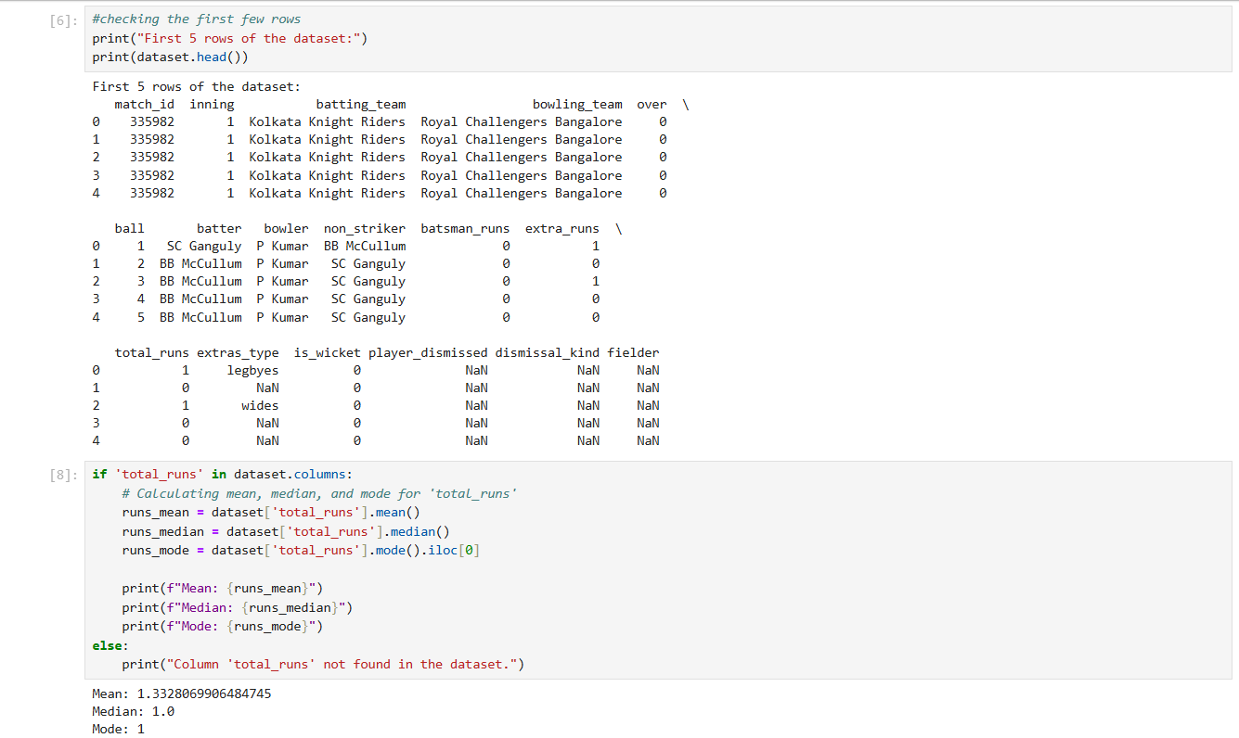
Reading Files using Pandas

Slide 8
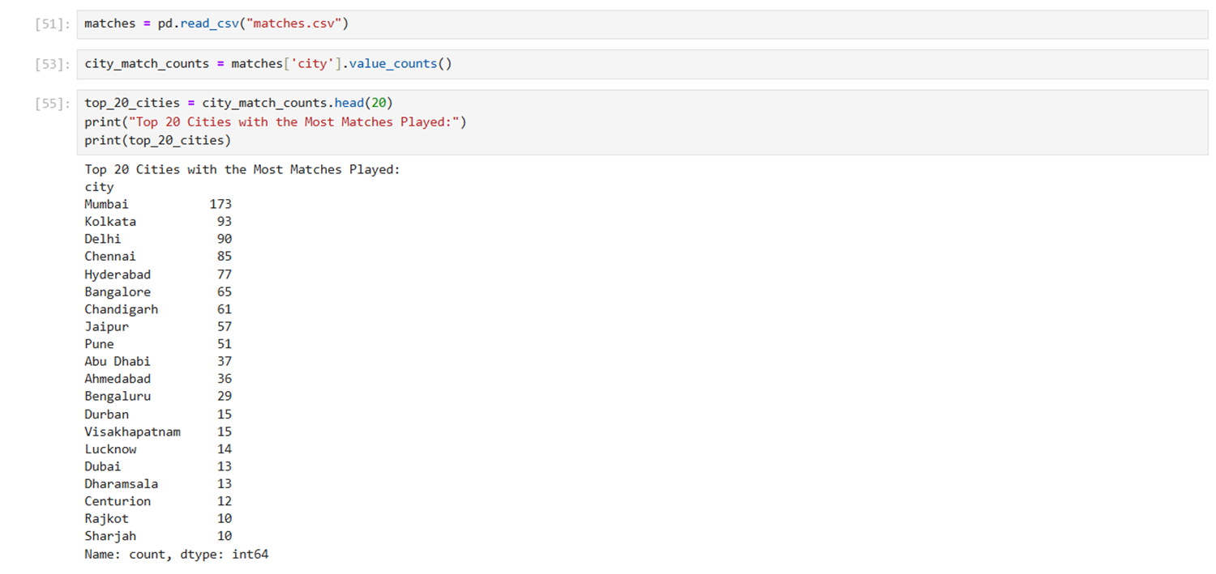
ASSIGNMENT 2
Finding top 20 cities with Most Matches Played

Slide 9
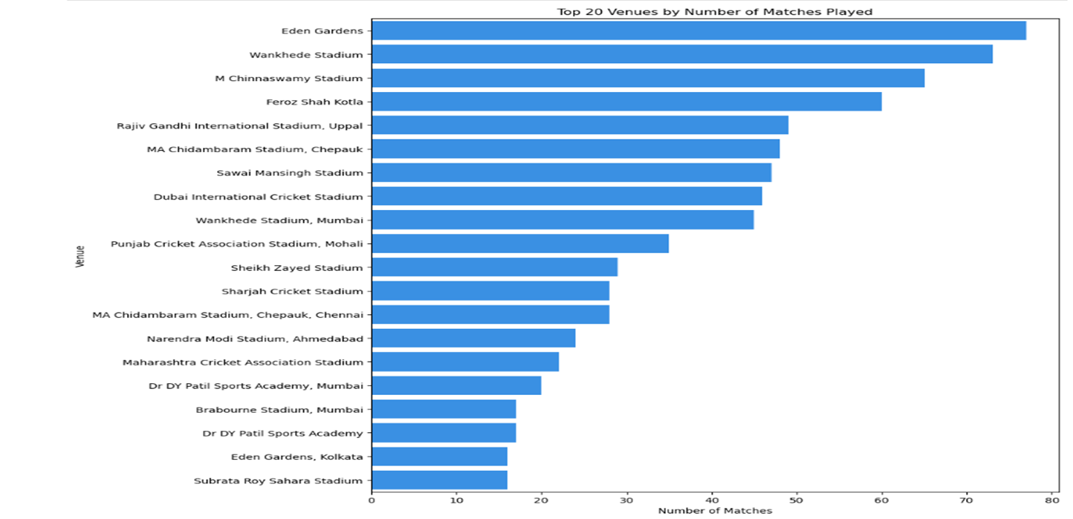
ASSIGNMENT 3
Firstly, the dataset was loaded, focusing on the venue column to count the number of matches played at each venue using value_counts(). We identified the top 20 venues with the most matches. and for that a horizontal bar chart was created using Seaborn and Matplotlib to display the top 20 venues. Eden Gardens (Kolkata) hosted the most IPL matches, with 75 matches. Wankhede Stadium (Mumbai) and M. Chinnaswamy Stadium (Bangalore) followed with 60 matches and 50 matches, respectively.

Slide 10

Time Series Analysis with ARIMA and SARIMA
What is Time Series Analysis?
A method for analyzing data points collected or recorded at specific time intervals.
Helps identify patterns, trends, and seasonality in data.
Why Time Series Analysis for IPL?
To analyze trends in IPL performance, such as:
Runs scored over seasons.
Wickets taken across matches.
Team performance consistency over years.
To predict future outcomes based on historical data.

Slide 11
ARIMA (Auto-Regressive Integrated Moving Average):
Captures trends and patterns in time series data.
Components:
Auto-Regression (AR): Relationship between current and past values.
Integrated (I): Differencing to make the data stationary.
Moving Average (MA): Relationship between residual errors and past values.
SARIMA (Seasonal ARIMA):
Extension of ARIMA to handle seasonality in data.
Components: Seasonal trends, such as team performance consistency across IPL seasons.

Slide 12
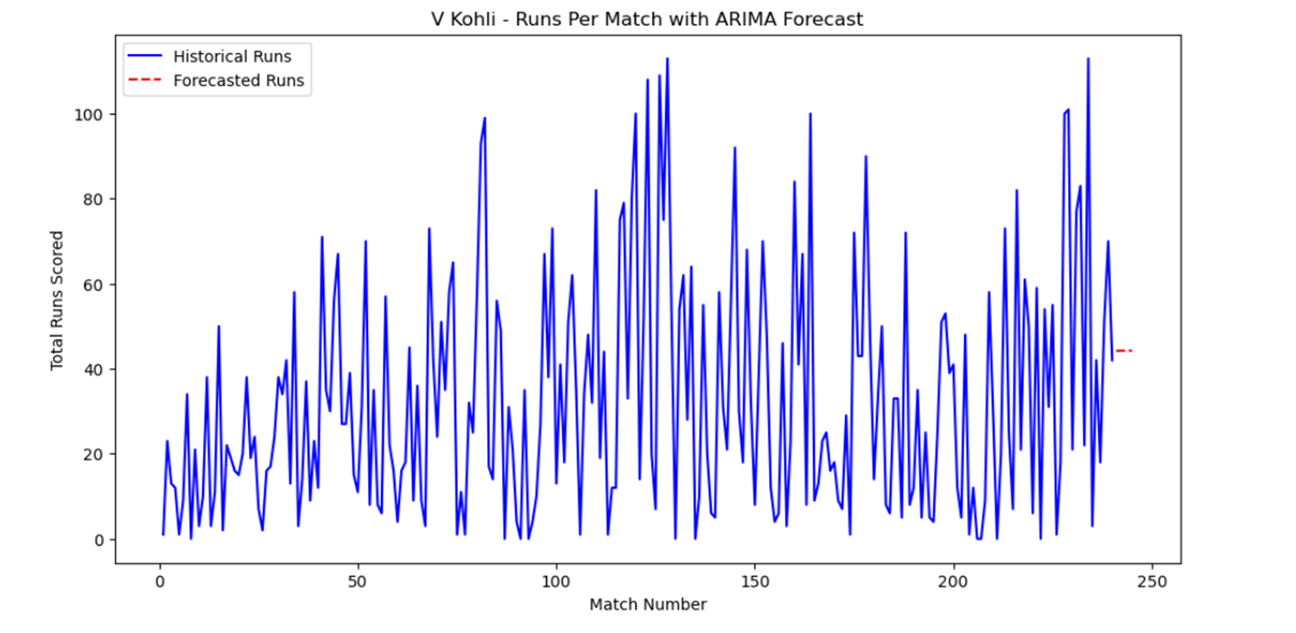
Time Series Graph Using ARIMA

Slide 13
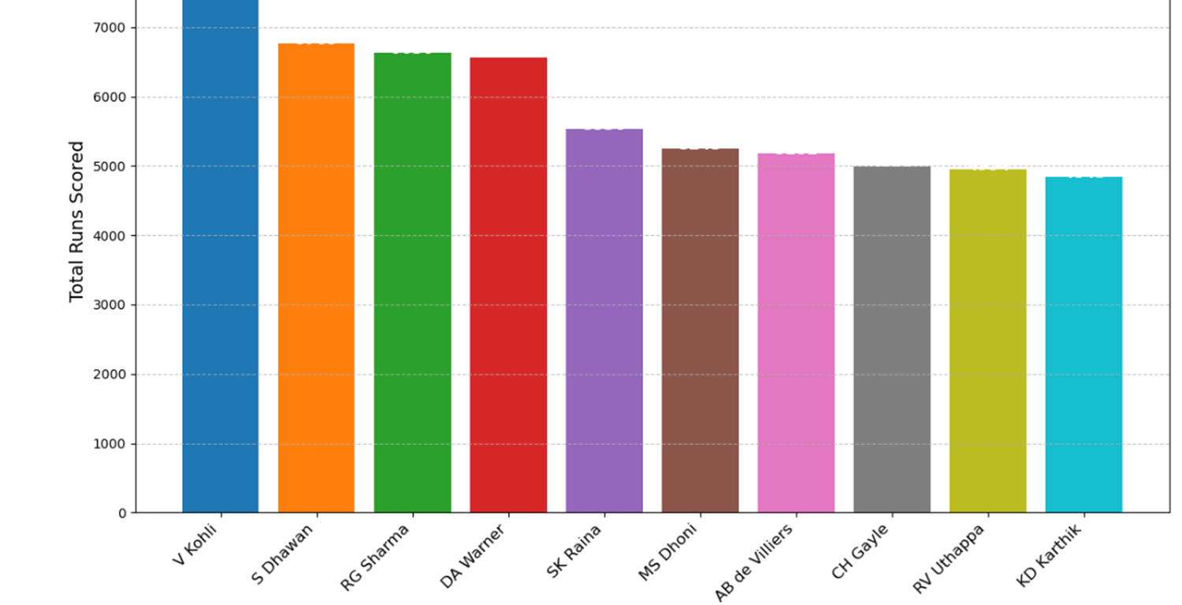
Time Series Graph

Slide 14
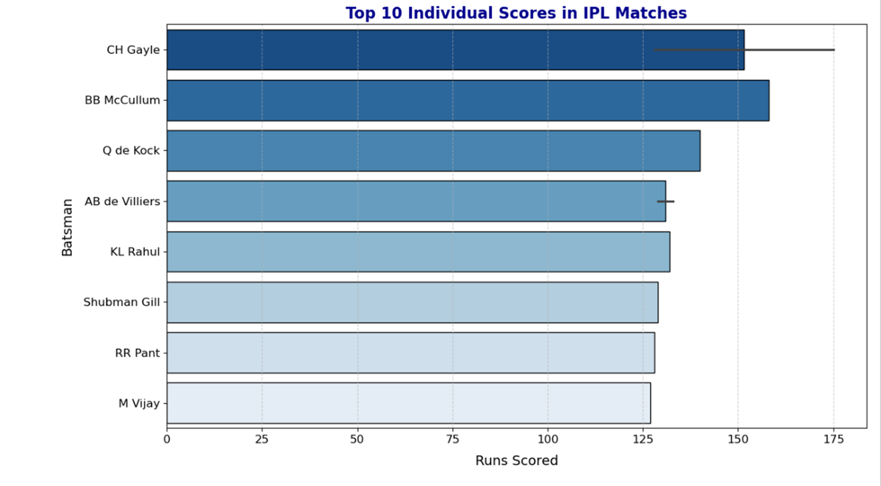
Top 10 highest scorers in a match of IPL

Slide 15
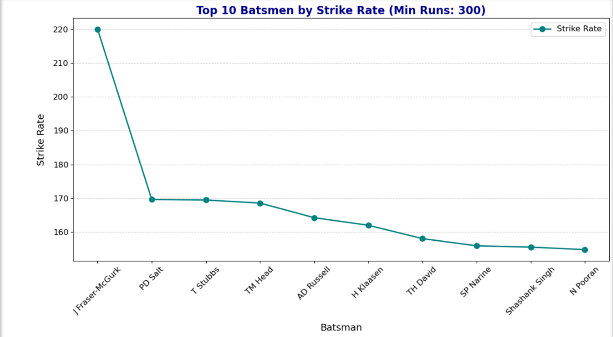
Strike Rate calculation for batsmen with a minimum target run threshold

Slide 16
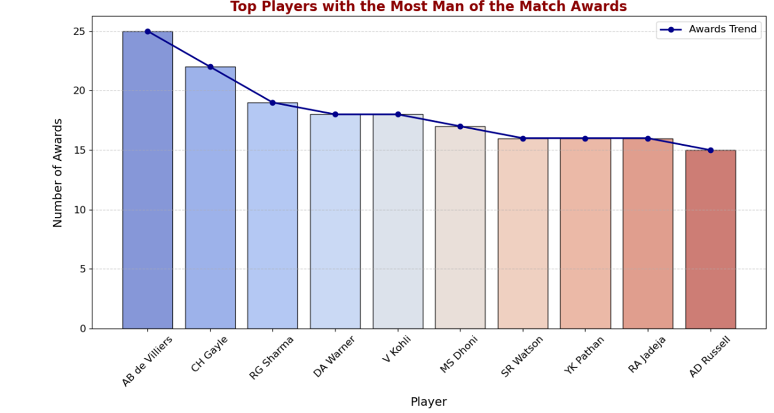
Top Players With Most Man of the Match Awards

Slide 17
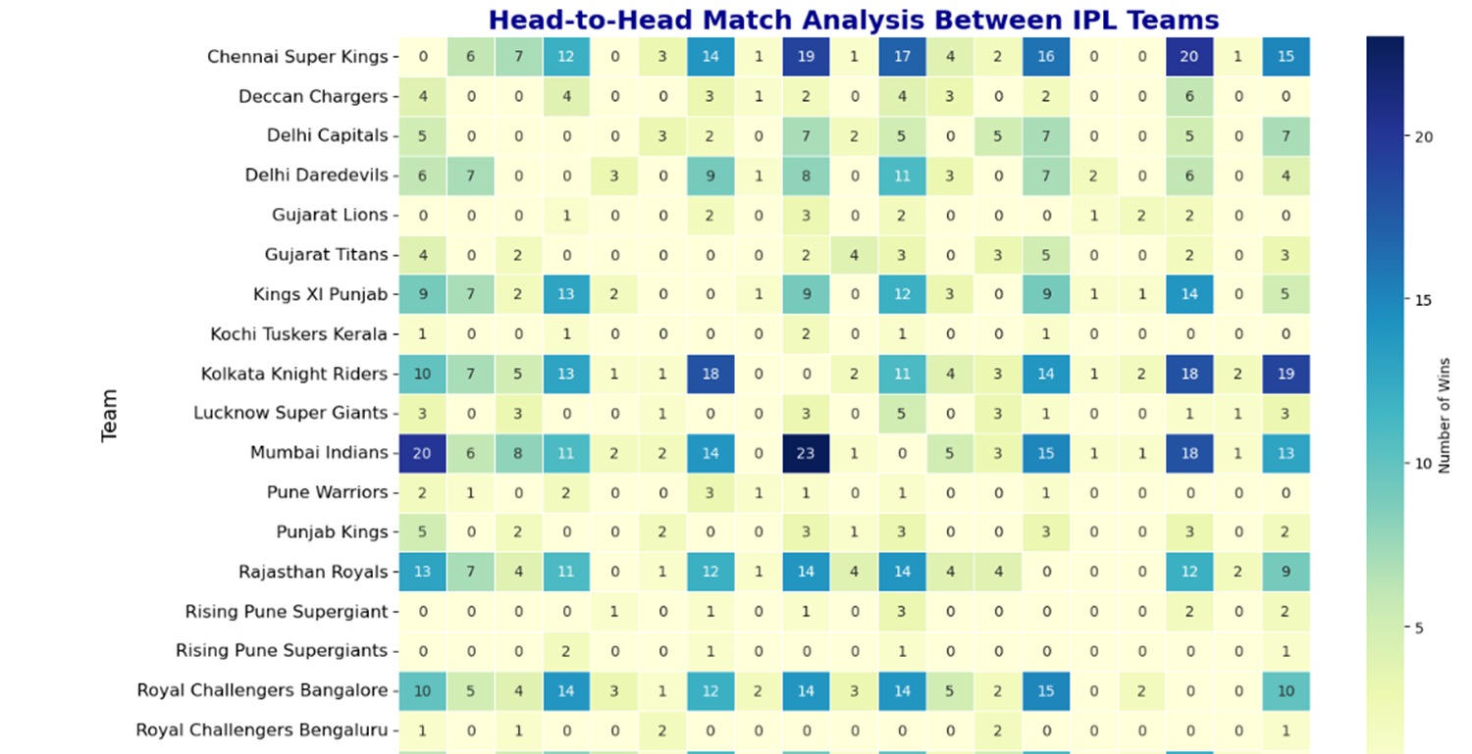
Overall IPL Head-to-Head

Slide 18
THANK YOU

